Slide 1
The Impacts of the Oil Price and Policy Uncertainty on Canadian Real Economic Activities: An SVAR Approach
Final Oral Defense in Partial Fulfillment of the Requirements for the Degree of
MASTER OF ARTS
in the Department of Economics
Jitong (Jeff) Yang
June 21st, 2021

Slide 2
Outline
1. Introduction
2. Literature Review
3. Data
4. Methodology
5. Results
6. Conclusion & Further Studies

Slide 3
1. Introduction
Both the oil price and policy uncertainty are important determinants of economic development.
The daily consumption of crude oil is around 1.5 million barrels in Canada (Canadian Association of Petroleum Producers, n.d.).
If unexpected factors occur (e.g., recession, pandemic, disaster, etc.), the government might delay implementing effective policies, so policy uncertainty arises.
My research build on the existing literature by examining the case in Canada and using several production variables (i.e., industrial, manufacturing, construction) as a proxy for real economic activity. This allows me to examine the impact of oil price movements and policy uncertainty on different aspects of economic activity.

Slide 4
2. Literature Review
Killian (2009):
Adopted the structural VAR (SVAR) approach to examine the associations among the oil supply shock, aggregate demand shock, and oil specific demand shock on a global scale.
Both demand shocks have a persistently positive effect on global real economic activity.
Kang and Ratti (2013):
Extended Killian’s (2009) SVAR model by incorporating policy uncertainty and real stock returns.
The IRFs indicated that U.S. real activity varies positively with oil specific demand shock and varies negatively with policy uncertainty shock.
The forecast error variance decompositions (FEVDs) revealed that oil specific demand shock and policy uncertainty shock jointly explain 30% of the variability in U.S. real stock return.

Slide 5
2. Literature Review
Elder and Serletis (2009):
Studied how the oil price volatility influences the outputs from four Canadian industries (i.e., good producing, service producing, industrial production, and mining, oil, gas extraction) through using a multivariate GARCH-in-mean SVAR model.
A higher volatility tends to significantly reduce the outputs from all but service producing sector.
Mehrara and Sarem (2009):
Discovered how the industrial output of three oil-exporting countries responded to oil price shocks.
Conducted Granger causality and cointegration tests.
An oil price shock Granger causes Iranian and Saudi Arabian output growth over both the short-run and the long-run.

Slide 6
3. Data
Observations: Monthly series from January 1986 to June 2020.
Data Source:
Oil Price: the spot price of West Texas Intermediate (WTI) crude oil, from the U.S. Energy Information
Policy Uncertainty: Canadian economic policy uncertainty index, from the Economic Policy Uncertainty website
Real Economic Activity: production indices of Canadian industrial, manufacturing, and construction activities, from the OECD Main Economic Indicators

Slide 7
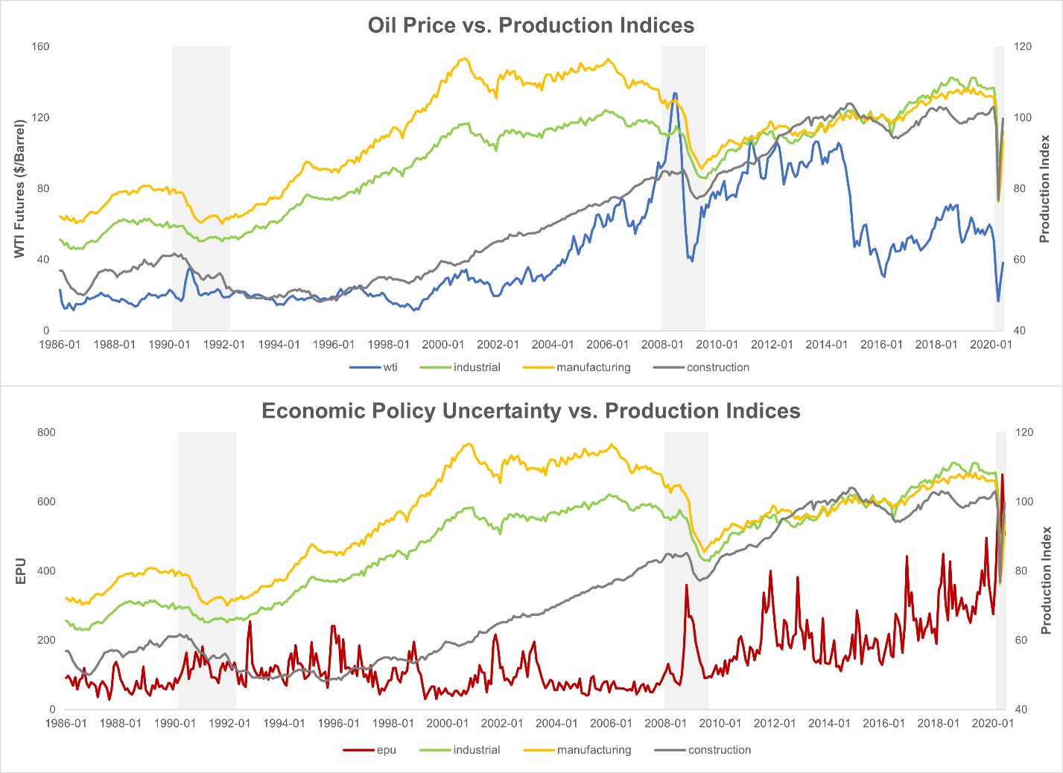
3.1 Time Series Plot
Trend: each series has an overall upward trend except the oil price series.
Correlations: economic policy uncertainty series seems to move in an opposite direction to other variables.
Cycles: apparent cyclical patterns seems evident for each series.

Slide 8
3.2 Covariance Stationarity
Augmented Dickey Fuller (ADF), Dickey Fuller GLS (DFGLS), KPSS tests
Null Hypotheses (H₀):
ADF & DFGLS: the series has a unit root
KPSS: the series is covariance stationary
I include 11 deterministic seasonal dummy variables and a linear trend in the testing equations as control variables
I select 11 augmentation terms to ensure the validity of the tests while using monthly data.
The critical value is based on α = 10% due to the low power of the tests.

Slide 9
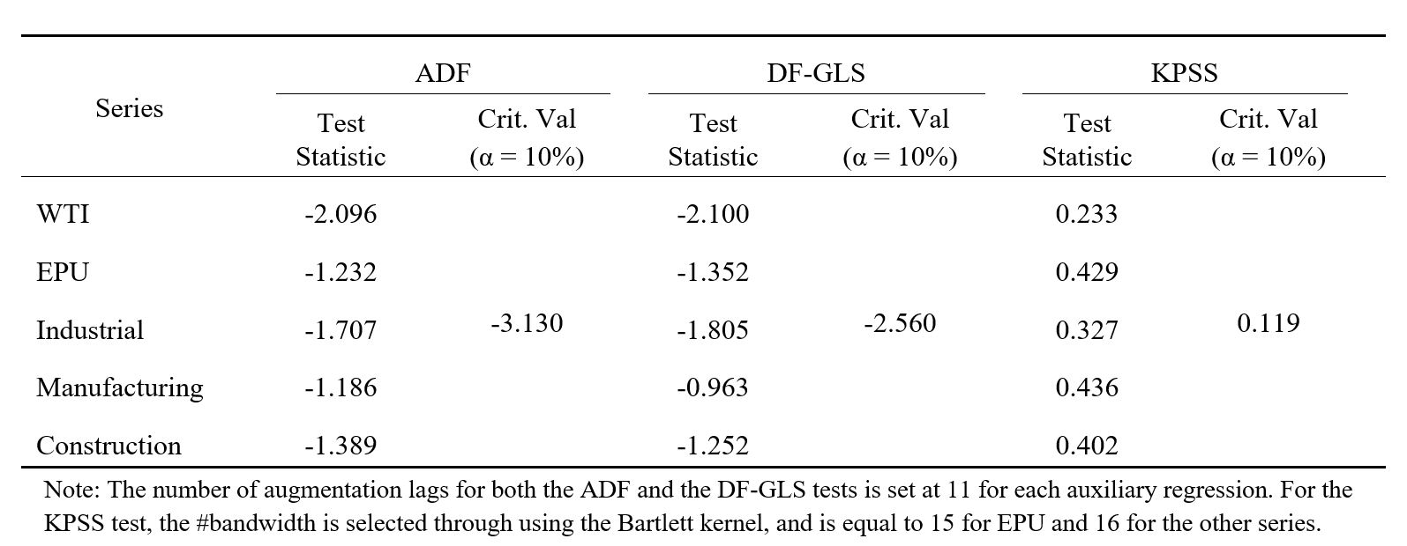
3.2 Covariance Stationarity
Each of the series is covariance non-stationary with at least one unit root.

Slide 10
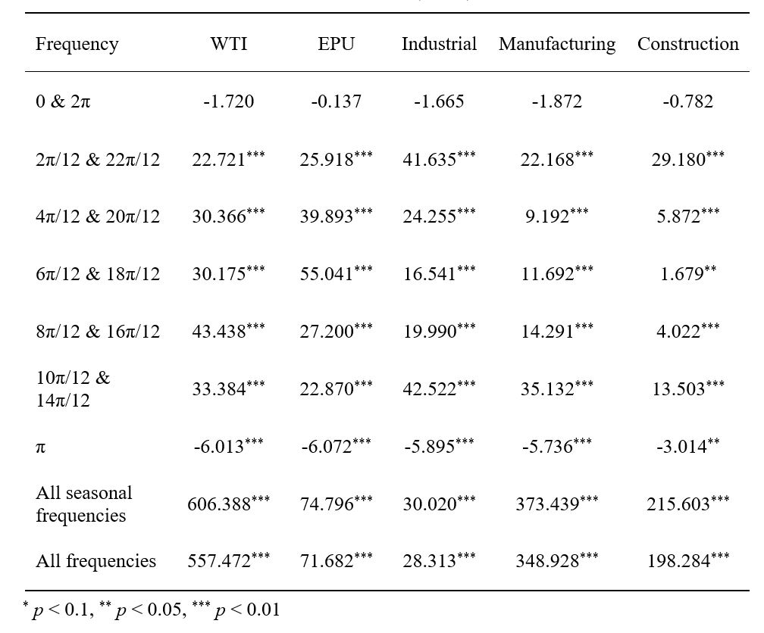
3.3 Seasonal Unit Roots
I undertake HEGY test to detect the presence of seasonal unit roots
Null Hypotheses (H₀): the series has a unit root at the specified frequency (or degree).
If a series has a unit root at the frequencies other than 0, we may say that the series exhibits a seasonal unit root.
The test results indicate that all series have a non-seasonal unit root but no seasonal unit roots.

Slide 11
3.4 Cointegration Test
I perform Johansen’s (1988, 1991) maximum-eigenvalue and trace tests to explore for possible cointegrating (long-term) relationships among the series in the same system.
Each system contain three series: the oil price, economic policy uncertainty, each production type. Therefore, I undertake the test for each considered production variable.

Slide 12
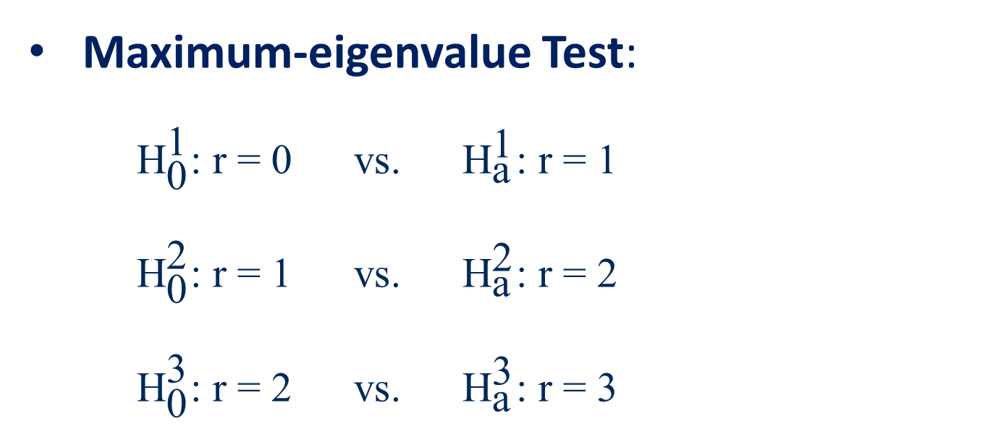
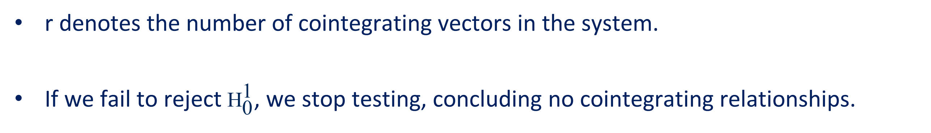

3.4 Cointegration Test
Maximum-eigenvalue Test:
${\text{H}}_{\text{0}}^{\text{1}}$: r = 0 vs. ${\text{H}}_{\text{a}}^{\text{1}}$: r = 1
${\text{H}}_{\text{0}}^{\text{2}}$: r = 1 vs. ${\text{H}}_{\text{a}}^{\text{2}}$: r = 2
${\text{H}}_{\text{0}}^{\text{3}}$: r = 2 vs. ${\text{H}}_{\text{a}}^{\text{3}}$: r = 3
Trace Test:
${\text{H}}_{\text{0}}^{\text{1}}$: r = 0 vs. ${\text{H}}_{\text{a}}^{\text{1}}$: r = 3
${\text{H}}_{\text{0}}^{\text{2}}$: r = 1 vs. ${\text{H}}_{\text{a}}^{\text{2}}$: r = 3
${\text{H}}_{\text{0}}^{\text{3}}$: r = 2 vs. ${\text{H}}_{\text{a}}^{\text{3}}$: r = 3
r denotes the number of cointegrating vectors in the system.
If we fail to reject ${\text{H}}_{\text{0}}^{\text{1}}$, we stop testing, concluding no cointegrating relationships.

Slide 13
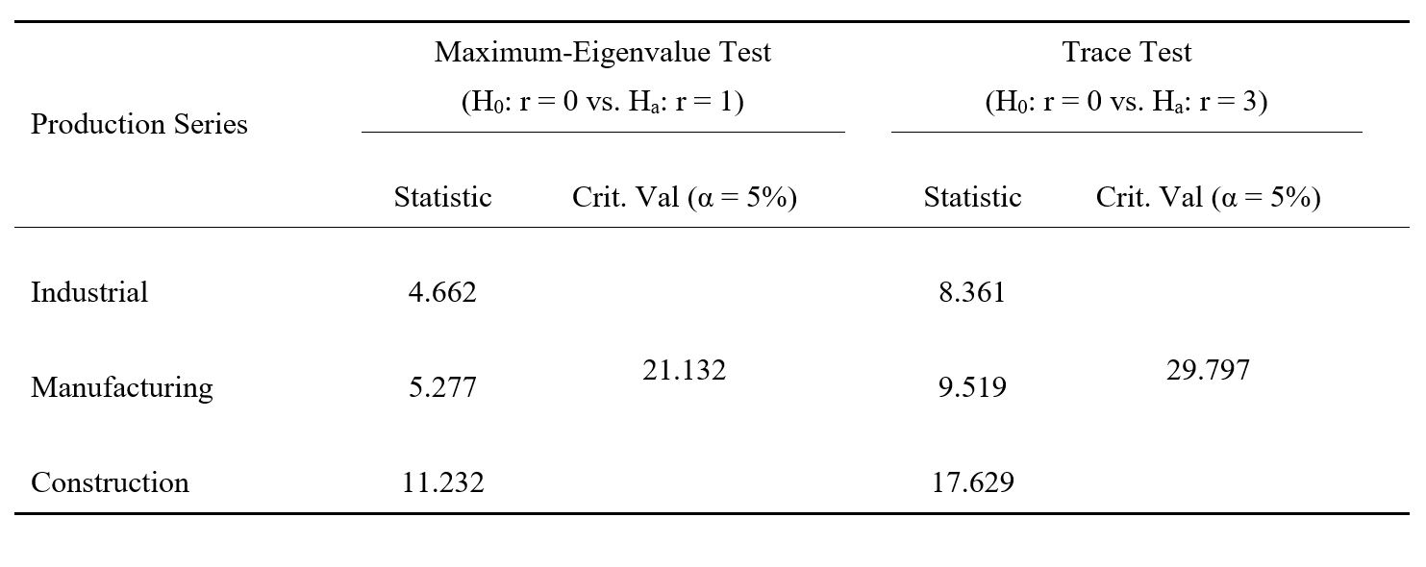
3.4 Cointegration Test
There are no cointegrating relationships in each system, and using the first difference of each series in the VAR estimation seems reasonable.

Slide 14
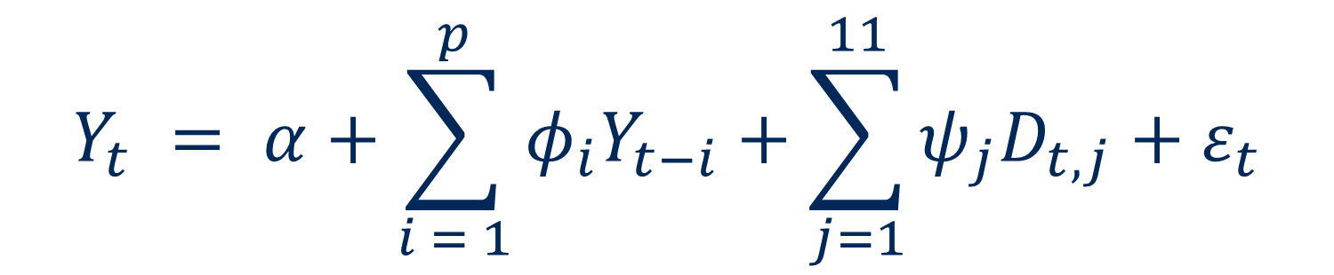
3.5 VAR Diagnostics
$$Y_{t} = α+\sum_{i = 1}^{p}{φ_{i}Y_{t−i}}+\sum_{j=1}^{11}{ψ_{j}D_{t, j}}+ε_{t}$$
Y_{t} = [Δwti_{t}, Δepu_{t}, Δproduction_{t}^{k}]′; k = industrial, manufacturing, or construction
Y_{t-i}: lagged values at order i
Φ_{i}: the (3 × 3) matrix of reduced-form autoregressive parameters
D_{t, j}: binary variable for the j^{th} month
ε_{t}: the (3 × 1) vector of reduced-form error terms
Based on the Akaike’s (1974) Info Criterion, choose p = 4 for the models consisting of industrial and manufacturing productions and p = 6 for construction production.

Slide 15
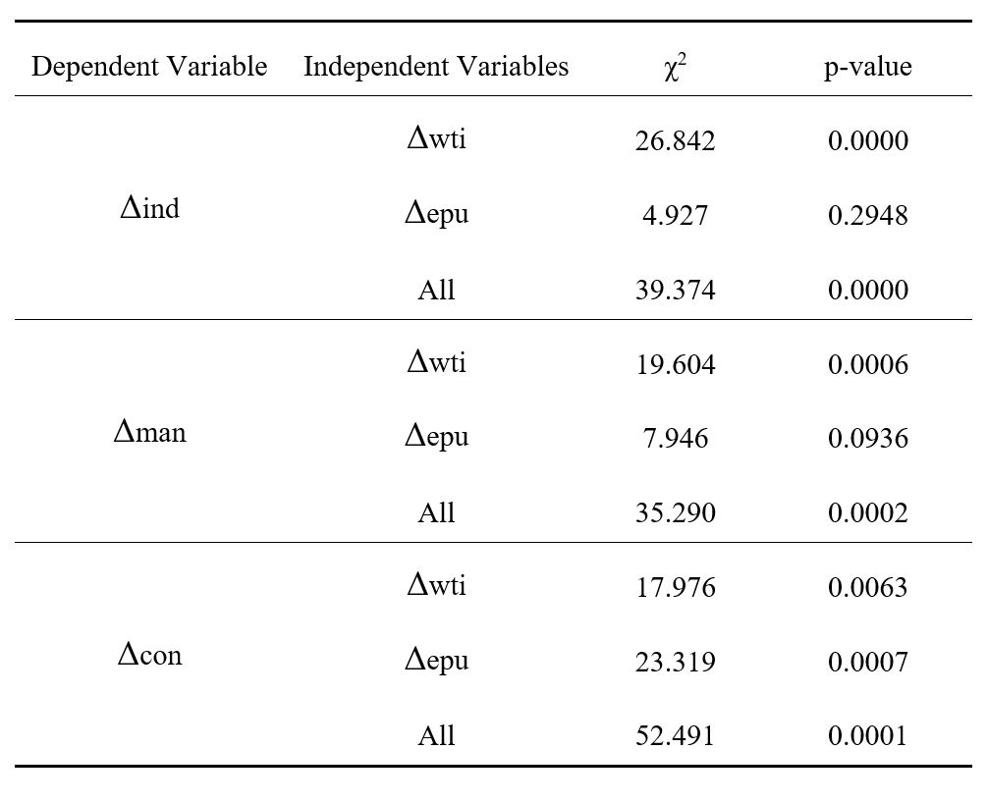
3.5 VAR Diagnostics
Granger’s (1969) non-causality test: tests for one-period ahead predictability.
Null Hypothesis (H₀): the lagged independent variable does not help explain or Granger cause the current value of the dependent variable.
The price of crude oil Granger causes all production types, while policy uncertainty only help explain construction production.

Slide 16
4. Methodology
Functional form
Identifying restrictions

Slide 17
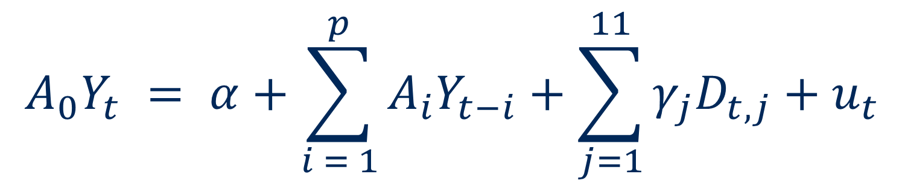
4.1 Functional Form
$$A_{0}Y_{t} = α+\sum_{i = 1}^{p}{A_{i}Y_{t−i}}+\sum_{j=1}^{11}{γ_{j}D_{t,j}}+u_{t}$$
A₀: the (3 × 3) contemporaneous coefficient matrix between the endogenous variables
A_{i}: the (3 × 3) matrix comprising the structural autoregressive parameters at order i
u_{t}: the (3 × 1) vector of structural error terms
I impose short-run restrictions via the error terms, as there are likely no cointegrating relationships amongst the oil price, policy uncertainty, and each real production.

Slide 18
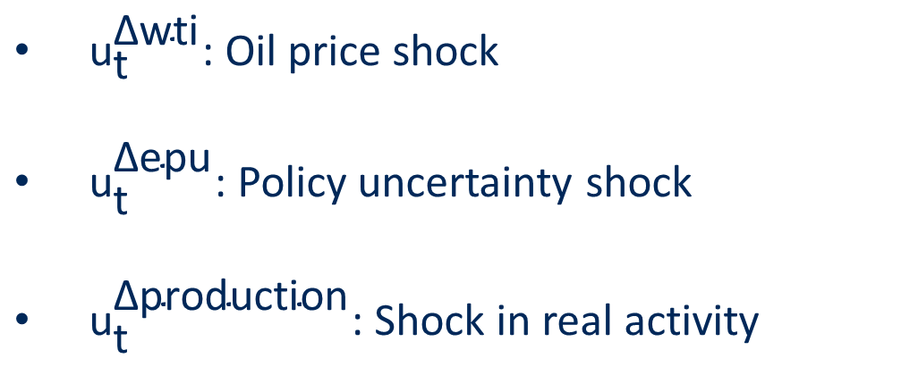
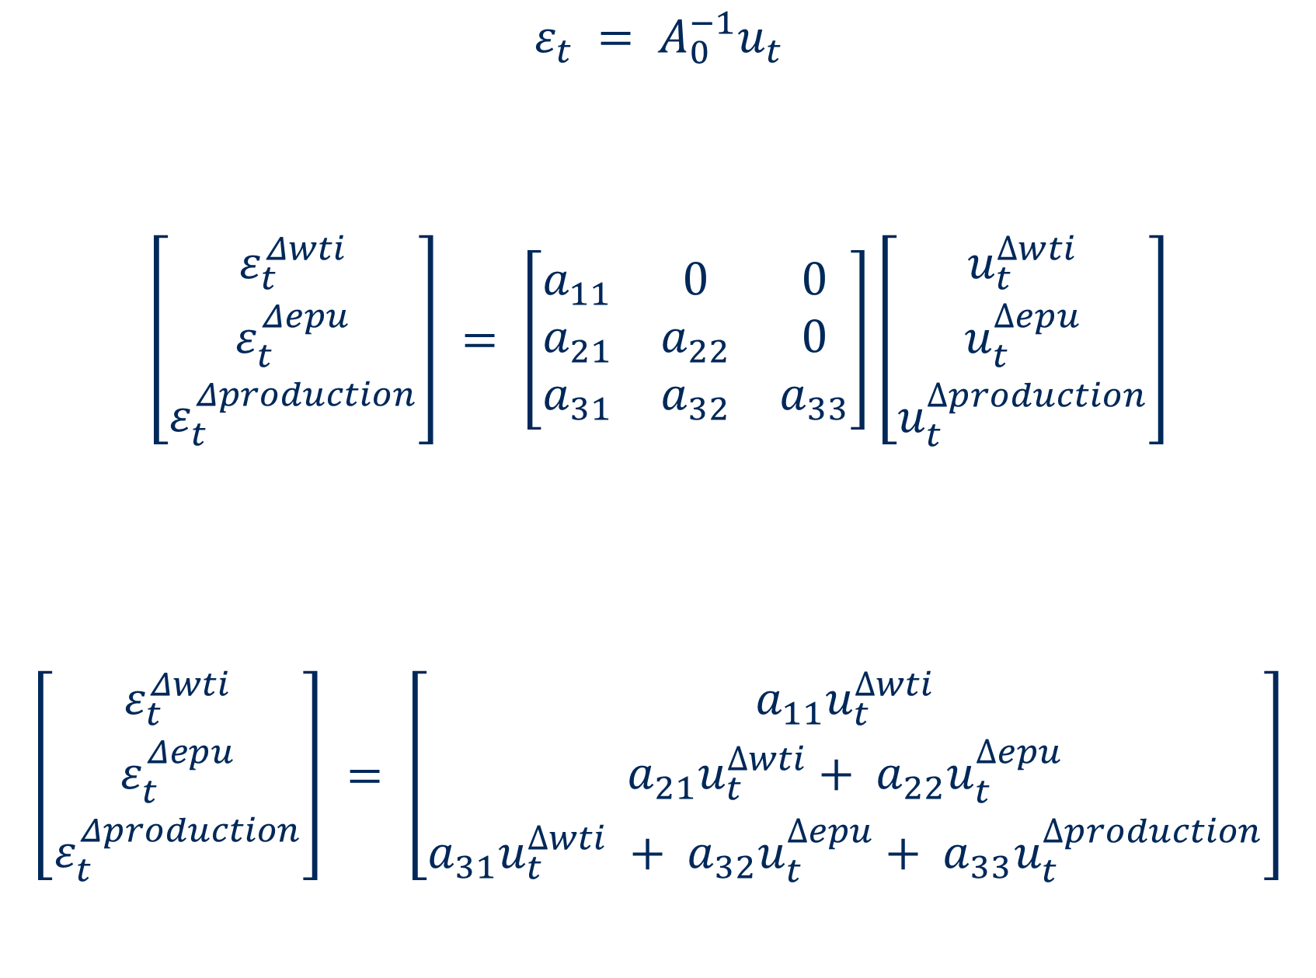
4.2 Identifying Restrictions – Expressions
$$ε_{t} = A_{0}^{−1}u_{t}$$
$$\left[\begin{matrix}ε_{t}^{Δwti} \\ ε_{t}^{Δepu} \\ ε_{t}^{Δproduction}\end{matrix}\right] = \left[\begin{matrix}a_{11} & 0 & 0 \\ a_{21} & a_{22} & 0 \\ a_{31} & a_{32} & a_{33}\end{matrix}\right]\left[\begin{matrix}u_{t}^{∆wti} \\ u_{t}^{∆epu} \\ u_{t}^{∆production}\end{matrix}\right]$$
$$\left[\begin{matrix}ε_{t}^{Δwti} \\ ε_{t}^{Δepu} \\ ε_{t}^{Δproduction}\end{matrix}\right] = \left[\begin{matrix}a_{11}u_{t}^{∆wti} \\ a_{21}u_{t}^{∆wti}+ a_{22}u_{t}^{∆epu} \\ a_{31}u_{t}^{∆wti} + a_{32}u_{t}^{∆epu}+ a_{33}u_{t}^{∆production}\end{matrix}\right]$$
${\text{u}}_{\text{t}}^{\text{∆}\text{wti}}$: Oil price shock
${\text{u}}_{\text{t}}^{\text{∆}\text{epu}}$: Policy uncertainty shock
${\text{u}}_{\text{t}}^{\text{∆}\text{production}}$: Shock in real activity

Slide 19

4.2 Identifying Restrictions – Economic Reasonings
$$\left[\begin{matrix}ε_{t}^{Δwti} \\ ε_{t}^{Δepu} \\ ε_{t}^{Δproduction}\end{matrix}\right] = \left[\begin{matrix}a_{11}u_{t}^{∆wti} \\ a_{21}u_{t}^{∆wti}+ a_{22}u_{t}^{∆epu} \\ a_{31}u_{t}^{∆wti} + a_{32}u_{t}^{∆epu}+ a_{33}u_{t}^{∆production}\end{matrix}\right]$$
The oil price does not respond to shocks in Canadian economic policy uncertainty and real activity because it captures the oil market price of the entire world.
A change in the oil price can affect Canadian policy uncertainty, as we cannot anticipate the direction of that change.
Both the world oil price and economic policy uncertainty are necessary determinants of domestic real economic activities.

Slide 20
5. Results
I interpret and discuss my empirical findings based on:
Impulse response functions (IRFs)
Forecast error variance decompositions (FEVDs)

Slide 21
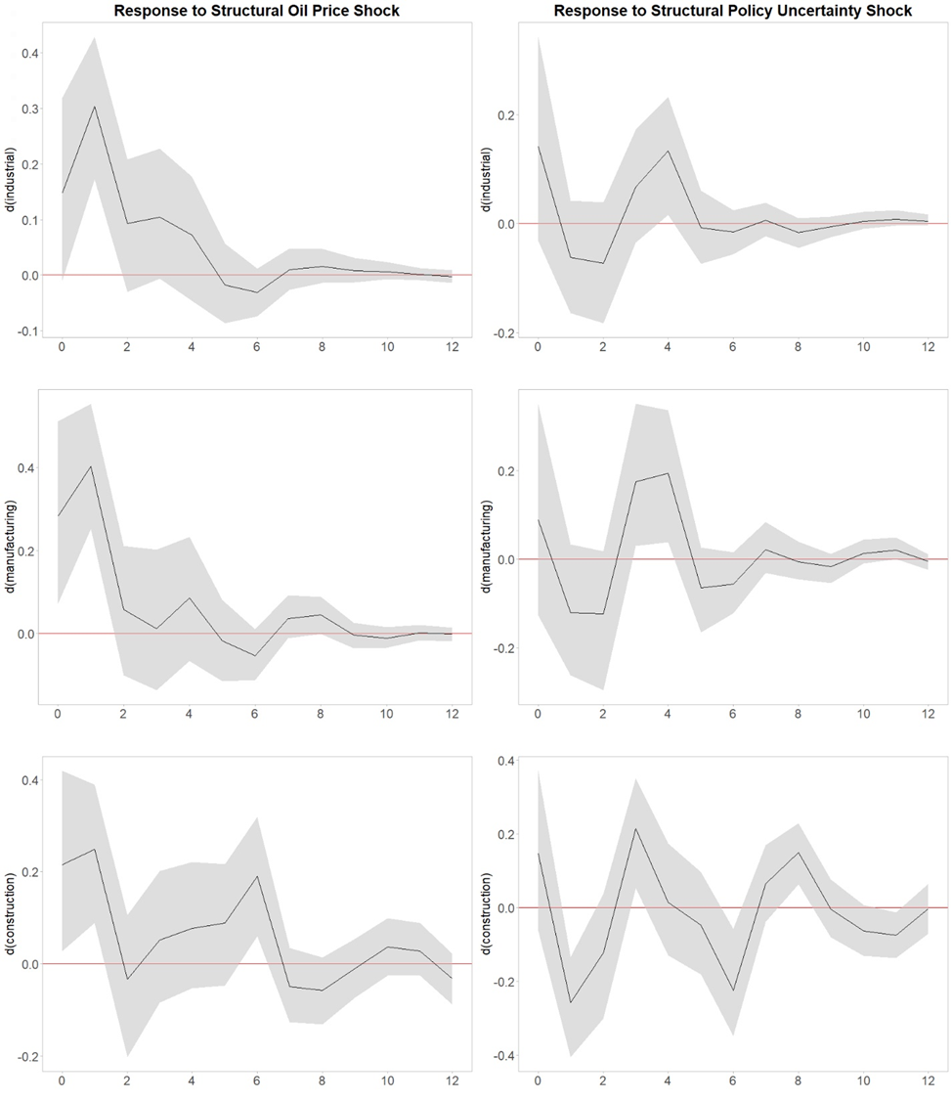
5.1 Impulse Response Analysis
The oil price shock leads to an instantaneous positive response for all types of real productions, but this effect dissipates quickly.
The policy uncertainty shock has a statistically significant impact on construction production, being negative instantaneously but becoming positive shortly thereafter.

Slide 22
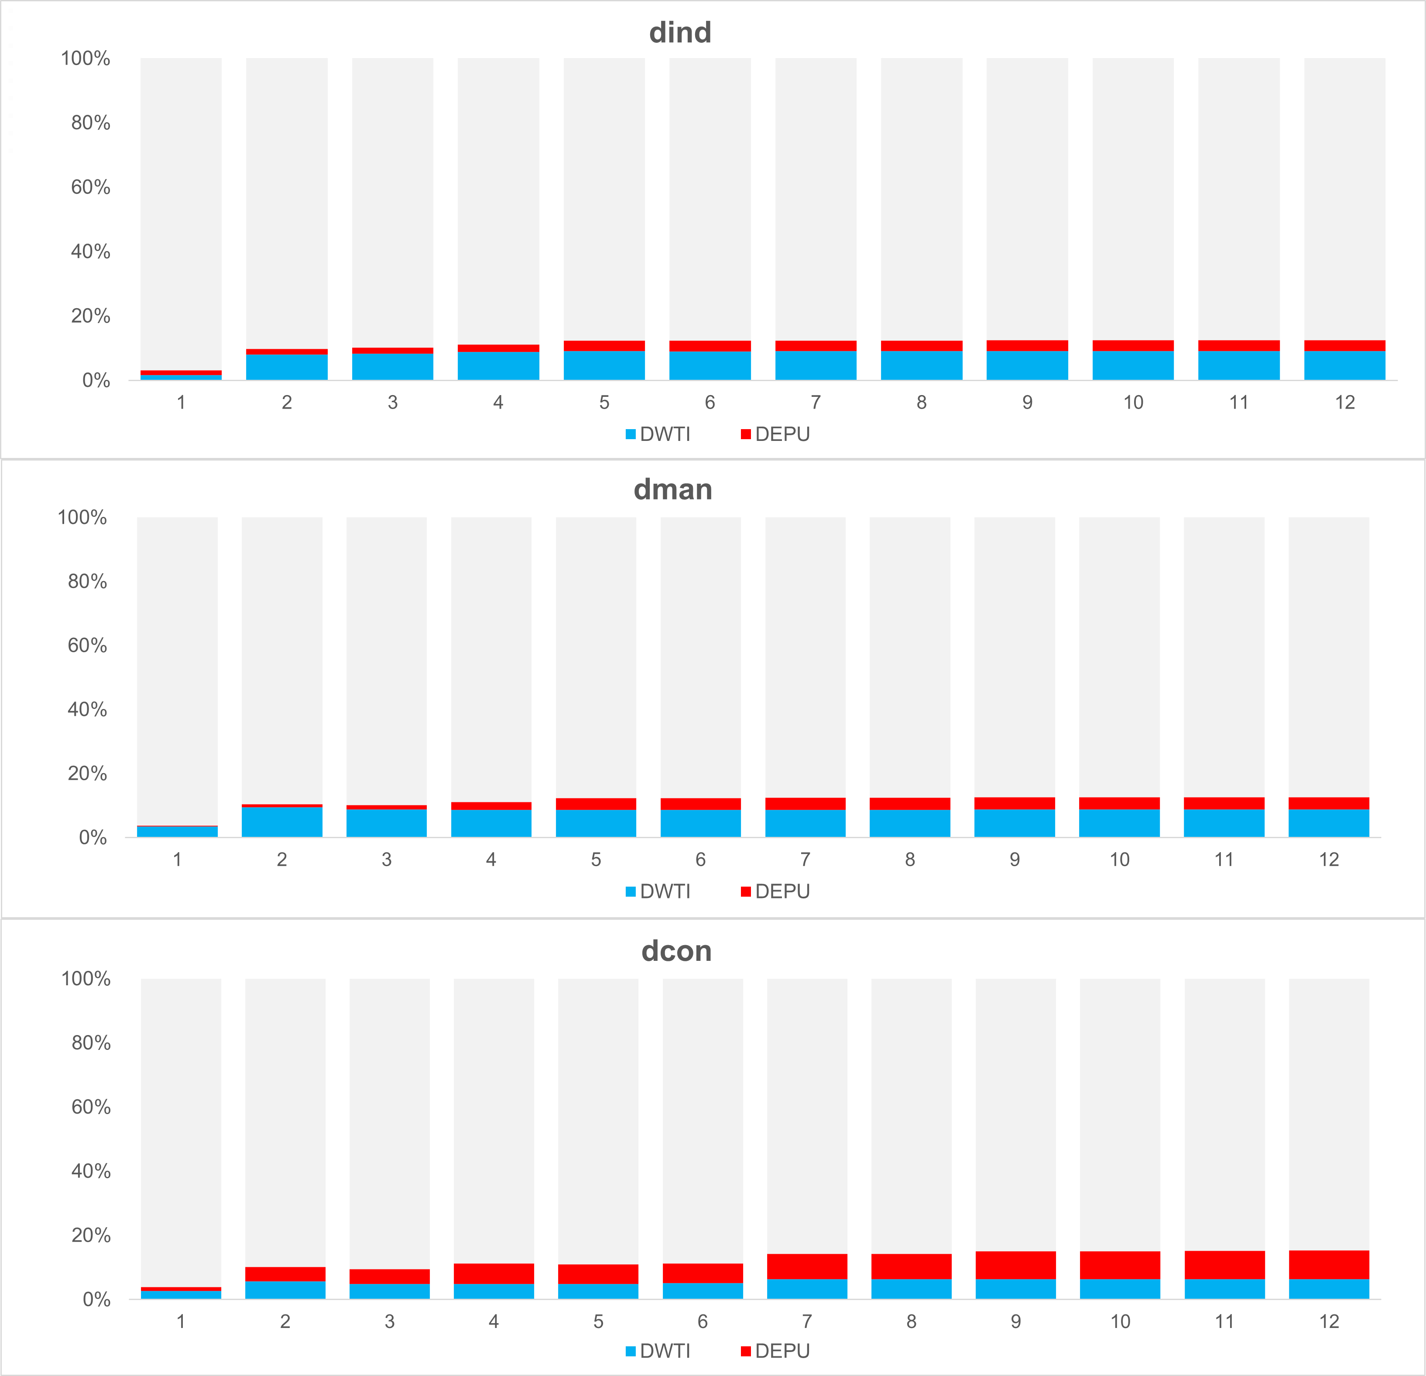
5.2 Forecast Error Variance Decomposition
The structural shocks to the oil price and to policy uncertainty jointly explain 15-20% of the forecast error variance in productions.
The oil price shock contributes a higher proportion of the variability in industrial and manufacturing productions than policy uncertainty shock; This is the inverse w.r.t. construction production

Slide 23
6. Conclusion & Further Studies
Summary of main findings:
The oil price Granger causes each production measures, while policy uncertainty only Granger causes real construction activity.
The oil price shock has a positive and instantaneous influence on all production types, while policy uncertainty shock leads to a significant but directional response for the construction production.
The shocks in the oil price and policy uncertainty jointly contribute to nearly one-fifth of the forecast variability in real economic activities.

Slide 24
6. Conclusion & Further Studies
Future works:
Undertake structural break tests to examine whether economic recessions significantly affect the interactions amongst the oil price, economic policy uncertainty, and real economic activity.
Explore the case in developing countries using the same methodology and compare the results with the scenario in Canada.

